Slide 1
Testbed activities

Slide 2
Testbed activities
Feasibility study
  Crucial to commercial success of any proposed networking technology & architecture is not only its performance evaluation by means of analysis or simulation but also a thorough feasibility study of its practical aspects
  Toward this end, proof-of-concept demonstrators, testbeds, and field trials play a key role
  Following survey provides up-to-date overview of latest testbed activities related to
    GMPLS
    WBS
    PSR
    OFS
    OBS
    OPS

Slide 3
Testbed activities
GMPLS testbeds
  LION
    European IST project Layers Interworking in Optical Networks (LION) is a multilayer, multivendor, multidomain managed IP/MPLS over ASON network with GMPLS-based control plane
    ASON framework facilitates set-up, modification, reconfigur-ation, and release of both switched & soft-permanent optical connections (lightpaths)
      Switched connections are controlled by clients
      Soft-permanent connection set-up & teardown initiated by NMS
    LION testbed comprises three domains consisting of OADMs & OXCs from different vendors
    For video-over-IP & CAD applications, set-up & teardown of soft-permanent connections through different domains using GMPLS signaling & interworking NMSs was experimentally validated
    Multilayer resilience tests were successfully carried out demonstrating MPLS fast reroute combined with optical restoration using a holdoff timer at IP/MPLS layer

Slide 4
Testbed activities
GMPLS testbeds
  GSN/GSN+
    Deutsche Telekom’s Global Seamless Network (GSN) field testbed comprises ASON/GMPLS-based backbone domain & several key client networks such as IP networks, carrier-grade Ethernet metro & access networks, SANs, and broadband video applications
    ASON/GMPLS backbone network consists of four SDH cross-connects & ultralong-haul WDM link
    GMPLS-based control plane provides clients with dynamic transport services via OIF UNI1.0, including automatic neighbor & service discovery
    UNI & E-NNI interoperability tests were carried out between client networks & multiple transport network domains in a multivendor environment
    Extended GSN+ demonstrator focuses on efficient transport of client traffic over ASON/GMPLS networks & interconnects GSN with other testbeds, e.g., MUPBED

Slide 5
Testbed activities
GMPLS testbeds
  MUPBED
    IST project Multi-Partner European Testbeds for Research Networking (MUPBED) aims at demonstrating a pan-European ASON/GMPLS-based research network
    MUPBED supports advanced applications & collaborative systems, e.g., Grids, disaster recovery, and business continuity
    MUPBED interconnects local testbeds using a layered multi-domain approach based on separation of applications & network services
    Different interaction models between Grid applications & net-work services are studied, e.g.,
      GUNI model
        Grid user-network interface (GUNI) according to overlay interconnection model
      API model
        Application programming interface (API) with several enhanced interaction requirements

Slide 6
Testbed activities
GMPLS testbeds
  DRAGON
    Dynamic Resource Allocation in GMPLS Optical Networks (DRAGON) testbed connects multiple academic, government, and research institutions via two interlocking WDM rings comprising five ROADMs
    DRAGON develops technologies that allow Grid computing & e-science applications to dynamically require deterministic network services (e.g., dedicated lightpaths) on an interdomain basis
    Control plane utilizes GMPLS as basic building block & includes extensions related to interdomain routing & signaling, integration of features for authentication, authorization, and accounting (AAA)
    Each domain has a network-aware resource broker (NARB) which allows for (1) 3D path computation with constraints for TE, AAA, and scheduling & (2) policy-based resource allocation
    End system can request set-up of application specific topology from application-specific topology builder (ASTB)

Slide 7
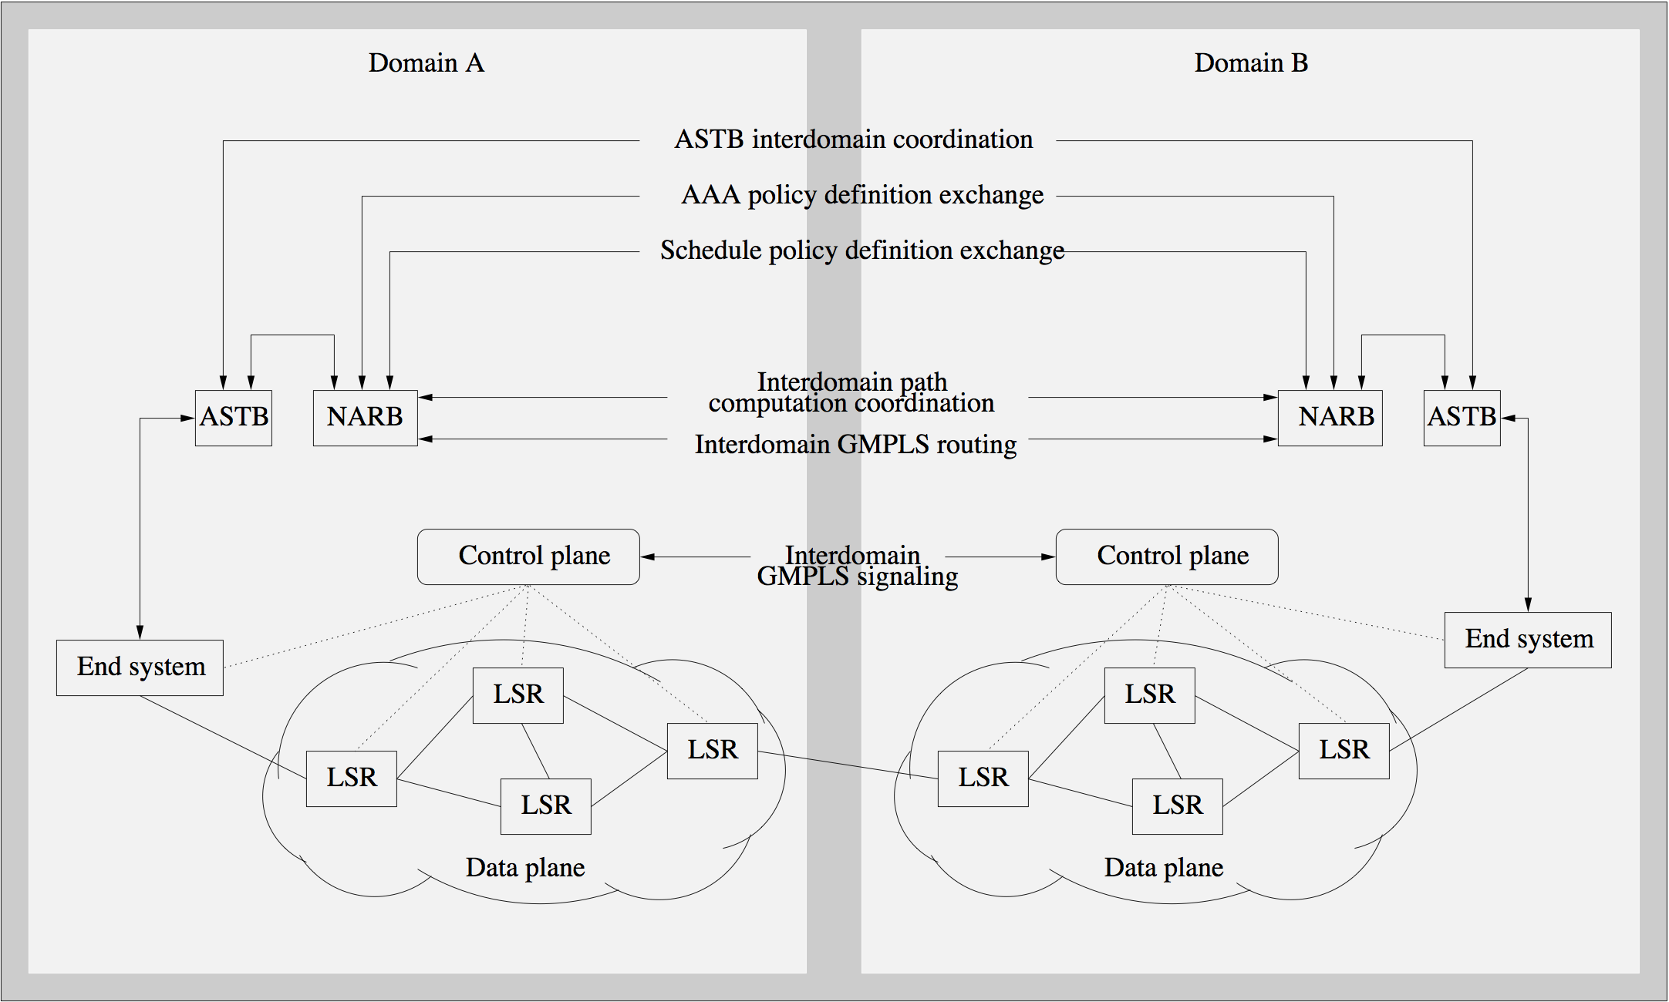
Testbed activities
GMPLS testbeds
  DRAGON

Slide 8
Testbed activities
GMPLS testbeds
  ONFIG
    Optical Network Focused Interest Group (ONFIG) program testbed is a GMPLS-controlled four-node WDM ring
    Main focus is on dynamic set-up of lightpaths with 1:1 protection for distributed storage service applications
    GMPLS-capable edge IP routers use web-based connection management system to set up/tear down lightpaths & perform traffic grooming
    HyperSCSI is used to demonstrate efficient SANs
    HyperSCSI is a lightweight transport protocol that sends data blocks in Ethernet frames over lightpaths without any TCP/IP overhead

Slide 9
Testbed activities
GMPLS testbeds
  KDDI
    Demonstration of IPv6 provider edge router approach, referred to as 6PE, for seamless IPv6 integration into GMPLS-controlled optical wavelength switching backbone networks
    6PE method relies on multiprotocol border gateway protocol (MP-BGP) extensions for 6PE routers to exchange IPv6 reachability information
    6PE BGP routers are dual stack (IPv6 & IPv4) using an IPv4 address for peer communication through IPv4 core
    Thus, IPv6 reachability can be achieved without any impact on existing IPv4 core networks

Slide 10
Testbed activities
GMPLS testbeds
  ADRENALINE
    ADRENALINE testbed is a hybrid platform whose transport plane consists of real ROADMs & fiber links as well as emulated optical nodes/links
    Beside GMPLS-based control plane, ADRENALINE deploys a distributed management plane by combining SNMP & user-friendly XML-based tools
    ADRENALINE provides soft-permanent connections & switched connections (lightpaths)
    Soft-permanent connections under user initiative are supported by combining management & control plane technologies
    ADRENALINE allows both topology & major characteristics of DCN to be modified

Slide 11
Testbed activities
GMPLS testbeds
  ODIN
    Optical Dynamic Intelligent Network (ODIN) services architecture extends ASON reference architecture through a service layer on top of control plane
    ODIN utilizes GMPLS-based control plane for dynamic provisioning of dedicated end-to-end lightpaths
    ODIN is an intermediary optical network service layer between high-performance distributed processes (e.g., Grid applications) & lower-level optical network services and resources
    Service layer is designed to provide higher degree of virtualization (abstraction) of network services/resources & to allow edge processes to directly address and control network resources

Slide 12
Testbed activities
GMPLS testbeds
  NetherLight/StarLight
    Service plane above legacy networks was introduced as a secure lightpath provisioning architecture
    Service plane is able to integrate different approaches for AAA & different types of control planes (e.g., GMPLS)
    Service plane encompasses software agents for AAA & Grid network services and is able to bridge domains, establish trust, and expose control to credited users/applications via an API
    Service plane was demonstrated in a transatlantic testbed

Slide 13
Testbed activities
GMPLS testbeds
  CHEETAH
    Circuit-switched High-speed End-to-End Transport Architect-ure (CHEETAH) testbed is designed as a circuit-switched add-on service to connectionless Internet service
    CHEETAH consists of end hosts equipped with two Ethernet NICs
      Primary NIC is connected to Internet
      Secondary NIC is attached to an Ethernet port of the enterprise MSPP
    MSPP maps GbE frames onto Ethernet-over-SONET (EoS) signals on SONET circuits that are dynamically set up using GMPLS
    End hosts execute routing decision algorithm that determines whether data is sent over Internet or CHEETAH circuit based on data transfer size & loading conditions
    CHEETAH provides fallback option which enables gradual upgrade of end hosts with CHEETAH capability

Slide 14
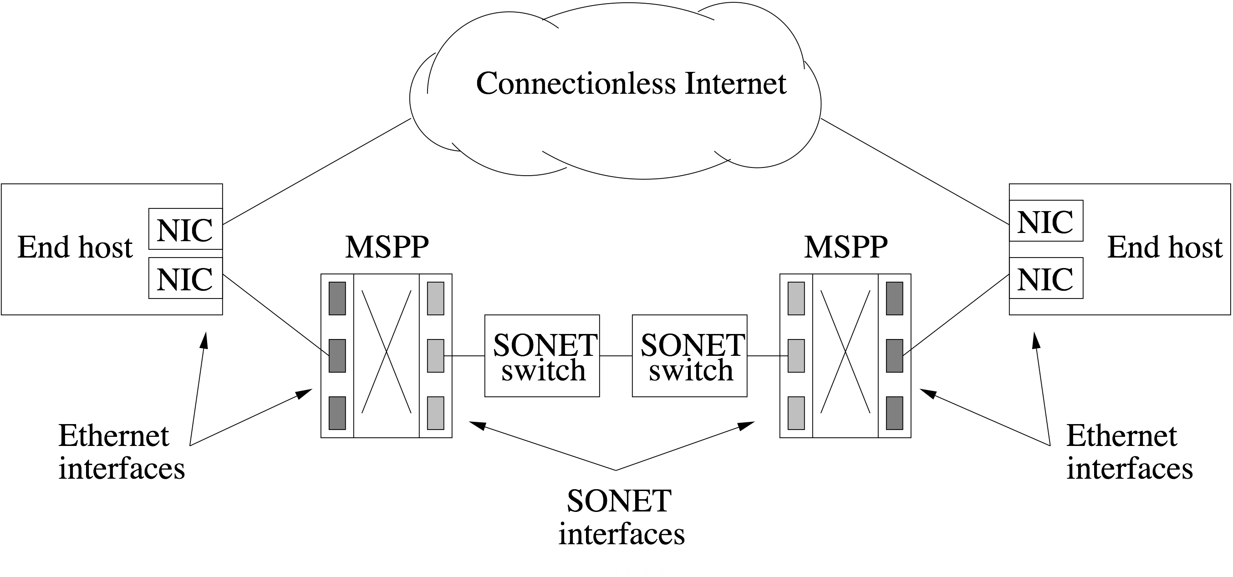
Testbed activities
GMPLS testbeds
  CHEETAH

Slide 15
Testbed activities
GMPLS testbeds
  USN
    UltraScience Net (USN) provides on-demand dedicated lightpaths for e-science applications carrying initially 10Gb/s SONET & 10GbE signals between MSPPs
    Centralized scheduler accepts user requests for setting up dedicated channels in future time slots subject to bandwidth availability & feasibility constraints
    Signaling daemon on central server uses GMPLS (or TL1 commands) to establish/release lightpaths
    Control plane is implemented using out-of-band VPN tunnels to encrypt control traffic & provide authenticated user & application access to USN

Slide 16
Testbed activities
WBS testbed
  ATDnet testbed
    Besides reducing port count, complexity, and costs of OXCs, wavebanding may also be used to upgrade capacity of existing transparent optical networks without requiring any changes to network elements
    On Advanced Technology Demonstration network (ATDnet), 4-channel 25-GHz-spaced waveband transmission in all-optical ring consisting of ROADMs with 200-GHz passband was demonstrated
    Four wavelengths generated at network edge fit within passband of ROADMs

Slide 17
Testbed activities
PSR testbed
  AT&T laboratories testbed
    Demonstration of PSR hubbed ring in which composite packets are generated locally at each node with a single tunable transmitter
    Composite packet consists of multiple fixed-size packets that are generated serially at different wavelengths
    Fixed-size packets are sent to a wavelength stacker consisting of an optical circulator followed by FBGs, each reflecting a different wavelength
    Resultant composite packet is sent in a single photonic slot
    Same set of FBGs in conjunction with additional circulator is used to unstack incoming composite packets
    Besides stacking & unstacking, switching of composite packets (photonic slots) was demonstrated by deploying a fast electro-optic 2 x 2 cross-bar switch at each PSR node

Slide 18
Testbed activities
OFS testbeds
  NGI ONRAMP
    Next Generation Internet Optical Network for Regional Access using Multiwavelength Protocols (NGI ONRAMP) testbed consists of bidirectional feeder WDM ring
    WDM ring connects via ROADM-based access nodes to passive optical distribution networks on which end users reside
    Demonstration of OFS achieving Gigabit-per-second throughput of TCP data between end-user workstations

Slide 19
Testbed activities
OFS testbeds
  CTVR
    Optical IP switching (OIS), a switching paradigm similar to router-initiated OFS, was demonstrated in Centre for Telecommunication Value Chain Research (CTVR) laboratory
    CTVR testbed consists of several IP routers attached to MEMS-based photonic switches
    In OIS, router monitors IP traffic & establishes optical cut-through (bypassing) path between its upstream and downstream neighboring routers when flow is detected
    Optical cut-through path initially involves only three adjacent routers
    It can subsequently extended by each router located at either end of optical path

Slide 20
Testbed activities
OBS testbeds
  ATDnet
    Demonstration of an OBS network overlaying three sites of ATDnet using JIT signaling
    In JIT signaling, an OBS node configures its optical switches for incoming burst immediately after receiving & processing corresponding control packet
  JumpStart
    Experimental study of JIT-based JumpStart architecture & protocols
    JumpStart provides QoS-aware constraint-based routing & multicast services
    Successful test of several applications (e.g., low-latency zero-jitter interactive visualization)

Slide 21
Testbed activities
OBS testbeds
  Optical Communication Center
    Demonstration of four-node OBS star network using JET signaling together with LAUC-VF scheduling algorithm
    JET signaling enables OBS nodes to make so-called delayed reservation for incoming bursts by using offset carried in each control packet
    With delayed reservation, optical switches at OBS nodes are configured right before expected arrival time of burst
    LAUC-VF keeps track of all void wavelength intervals & assigns arriving burst a large enough void interval whose starting is the latest but still earlier than burst arrival time

Slide 22
Testbed activities
OBS testbeds
  University of Tokyo
    Experimental study of JET-based OBS network using priority-based wavelength assignment (PWA) & deflection routing
    With PWA, edge OBS user increases priority of a wavelength if bursts have been successfully sent on this wavelength
    Otherwise, priority of wavelength is decreased
    Edge OBS user assigns wavelength with highest priority to assembled burst in order to reduce burst loss & mitigate contention
    Obtained results show that deflection routing helps reduce burst blocking probability more than PWA

Slide 23
Testbed activities
OBS testbeds
  JGN II
    Japan Gigabit Network (JGN) II testbed experimentally demonstrated two-way signaling to set up end-to-end connection prior to burst transmission
    Two-way signaling avoids contention at core OBS nodes
    It is suitable for metro area OBS networks with acceptable round-trip propagation delays
  Key Laboratory
    Key Laboratory of Optical Communication & Lightwave Technologies consists of two edge OBS nodes connected via a single core OBS node
    Core OBS node deploys LAUC-VF scheduling
    TCP performance was experimentally shown to degrade significantly for burst loss probabilities above 1%
    Demonstration of various applications with different QoS requirements using offset-time-based QoS scheme

Slide 24
Testbed activities
OPS testbeds
  RINGO
    Ring optical network (RINGO) project experimentally investigated unidirectional synchronous WDM ring
    Time is divided into equally sized slots, each able to carry one fixed-size packet
    Each node (or subset of nodes) is assigned a different home wavelength channel with a receiver fixed tuned to it
    Nodes deploy array of fixed-tuned transmitters, one for each home channel
    To avoid channel collisions, nodes check status of all wavelengths on a slot-by-slot basis & use empty slots to transmit locally generated packets

Slide 25
Testbed activities
OPS testbeds
  HORNET
    Hybrid Optoelectronic Ring Network (HORNET) is a bidirectional synchronous time-slotted WDM ring
    Each node is equipped with a fast-tunable transmitter & a receiver fixed tuned to its home wavelength channel
    Home channel may be shared by other nodes
    Separate control wavelength channel is used to convey availability information of all data wavelength channels
    Control channel undergoes OEO conversion at every node for processing & modifying wavelength availability information
    So-called segmentation and reassembly on demand (SAR-OD) access protocol allows nodes to use consecutive empty slots for transmitting variable-size packets

